Slide 1
Climate Change project update: week 3
Rens Breunissen,
Lotte van Dongen,
Markus Peschl,
Cecilia Casolo,
Maaike Elgersma,
Eva Slingerland,
Simon van Oosterom
Supervised by
Lorinc Meszaros [Deltares]
Robbert Fokkink [TU Delft]
Mathematical Data Science

Slide 2
Clustering, Neural Networks

Slide 3
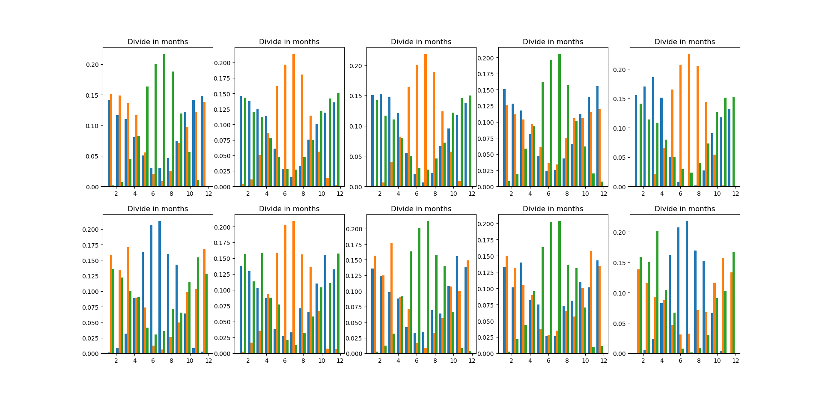
3) Clustering
Setup: standardized all variables, so gave all variables mean zero, variance 1. Next, applied Kmeans clustering for 1 station.
Fixed a bug that gave weird results.
Tried to see if clusters were different for different stations, wasn’t the case, see image on the right. This shows from left to right the clustering results for stations 1-5. Top shows clustering for first 10 years, bottom shows clustering for last 10 years.

Slide 4
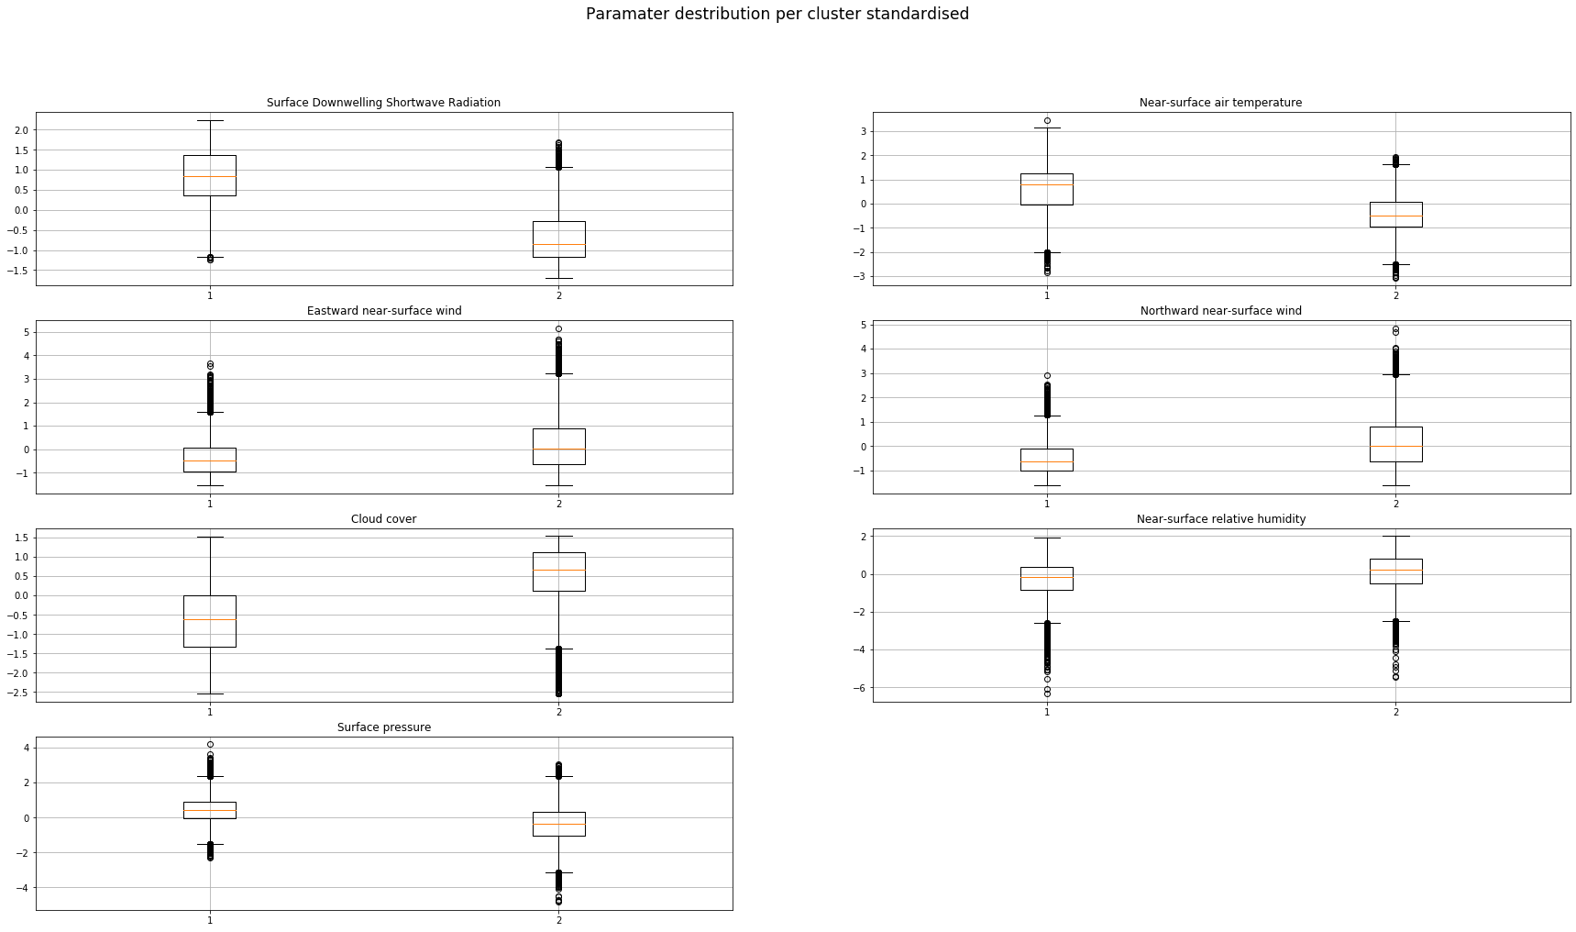
3) Clustering
Setup: standardized all variables, so gave all variables mean zero, variance 1. Next, applied Kmeans clustering for 1 station into 2 cluster (just like we did last week) which gave a ”summer” and a “winter cluster”.
Fixed a bug that gave weird results.
Looked at the difference between the distributions of each variable in the two clusters (left is summer cluster, right is winter cluster). A large difference means that it is an important indicator for differentiating between summer and winter.

Slide 5
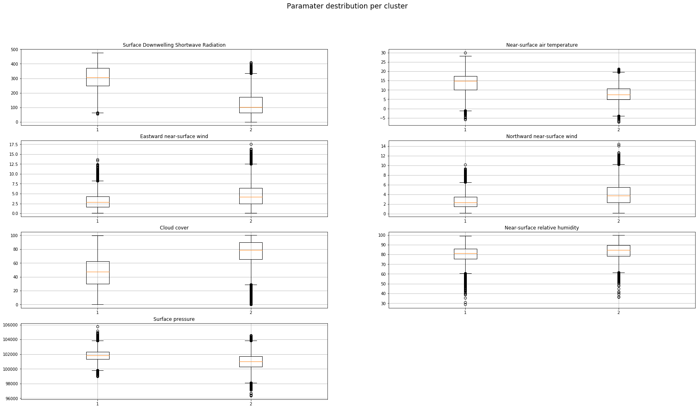
3) Clustering
Setup: standardized all variables, so gave all variables mean zero, variance 1. Next, applied Kmeans clustering for 1 station into 2 cluster (just like we did last week) which gave a ”summer” and a “winter cluster”.
Fixed a bug that gave weird results.
Here we see the same plot as in the previous slide, but now for the original non-standardised data. The are pretty much the same, as expected.

Slide 6
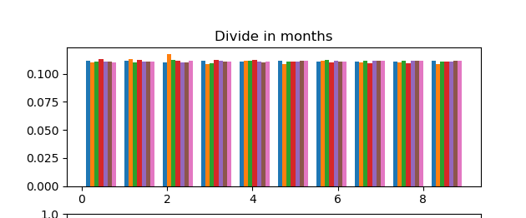
3) Clustering
Setup: standardized all variables, so gave all variables mean zero, variance 1. Next, applied Kmeans clustering for 1 station.
Fixed a bug that gave weird results.
Tried to see if we could cluster per station, wasn’t successful. Image shows the relative amount of points of each cluster, per station. Everything almost the same, as expected since data points between different stations don’t differ much, so clustering will most likely cluster based on seasons, and not on location.

Slide 7
Model prediction
Furthermore, we looked into the possibility of predicting the variables from one model based on the values from another model and a part of its own history.
First steps into multi linear regression were done, however the results will be shown next week.
Other methods used are neural networks and K-means

Slide 8
Model Prediction using dense ANN’s
Experimental Setup. Splitting data into training and test sets: We took the first 1000 days from two different models and created a labeled training set from that. This means the input is a vector of variables for one day of model 1 and the label is the vector of variables for model 2.
The task is to predict from a vector of observations for model 1 the corresponding vector of observations for model 2. Note that we did not (yet) use recurrent neural networks to take into account the relationship between different time steps. However, already for a simple dense ANN the results are surprisingly pretty convincing.

Slide 9
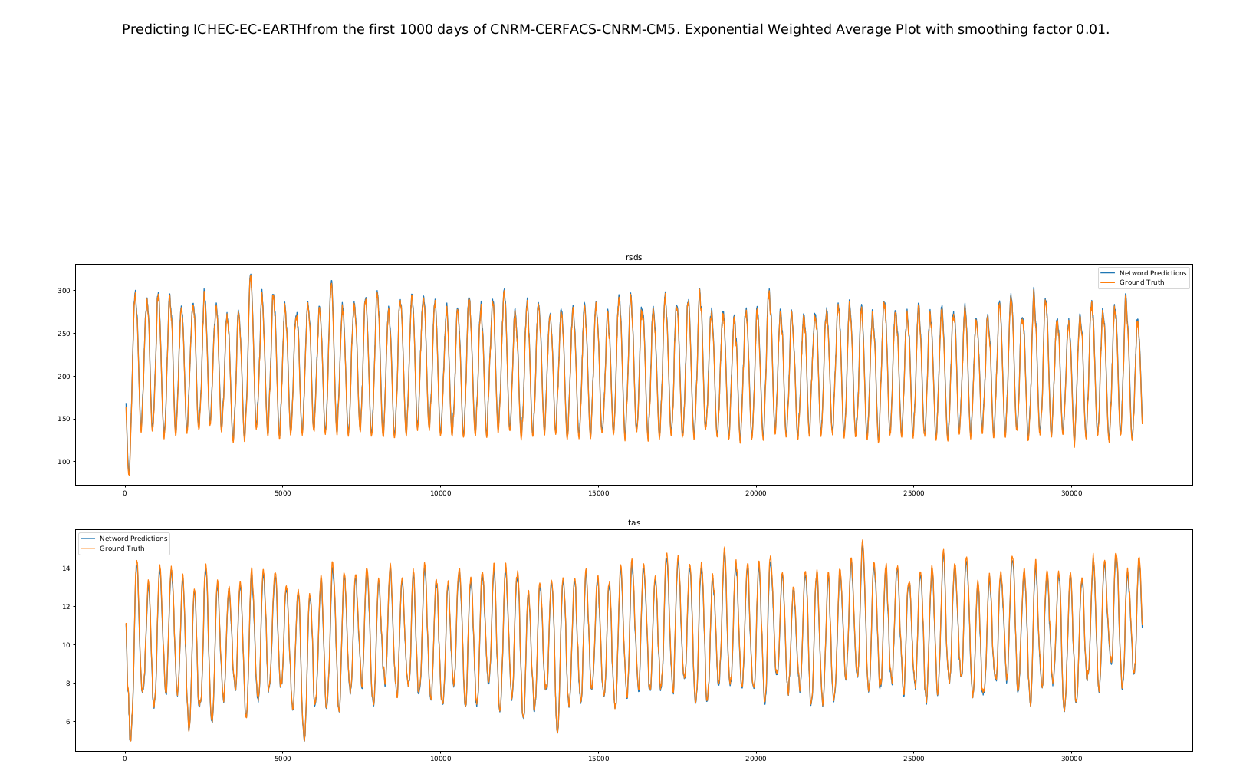

Slide 10
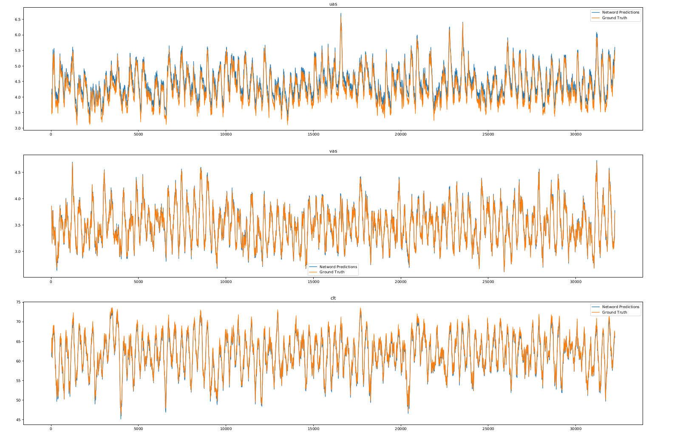

Slide 11
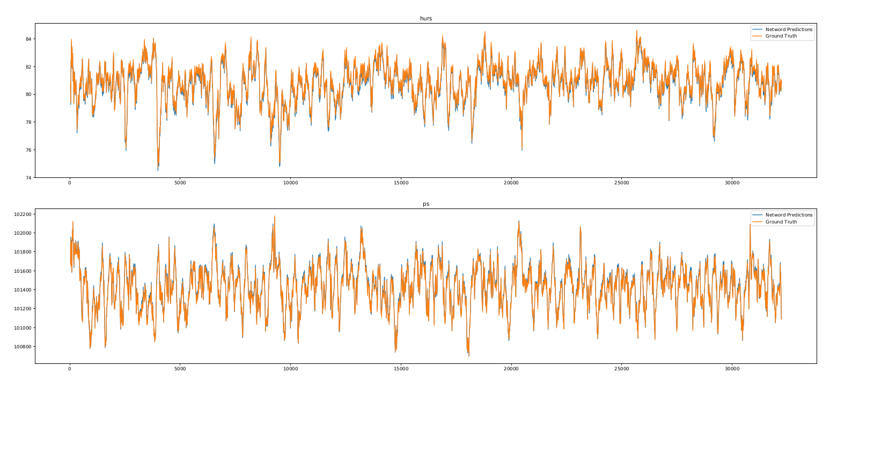

Slide 12
Model Prediction using dense ANN’s
To do: Generalize this to different models and compare performances as well as to play around with the training set size (e.g. only having the first 100 days poses a bigger challenge since the network never gets to see certain months)
Questions that arise here: How to make the task more challenging? What other predictions could be useful in this context?

